Slide 1
Accessing Census Data for Title VI Program Plans
2026 Training Sessions
NC Department of Transportation
Kelly Karres, Data Dissemination Specialist, U.S. Census Bureau

Slide 2


Session Overview: What to Expect
Brief Intro to the U.S. Census Bureau
Finding the Data You Need for Title VI Plan
Where the data comes from
Where the data are located
Things to keep in mind
Data Training
Go step by step through the process of accessing data
Use the table shells in the plan as our guide

Slide 3














U.S. Census Bureau: Who We Are What We Do…Censuses, Surveys + Programs

Slide 4

Nationwide household survey
Sample size of 3.5 million addresses
Designed to provide communities with reliable and timely social, economic, demographic and housing data every year
Part of the decennial Census program
What is the American Community Survey (ACS)?

Slide 5

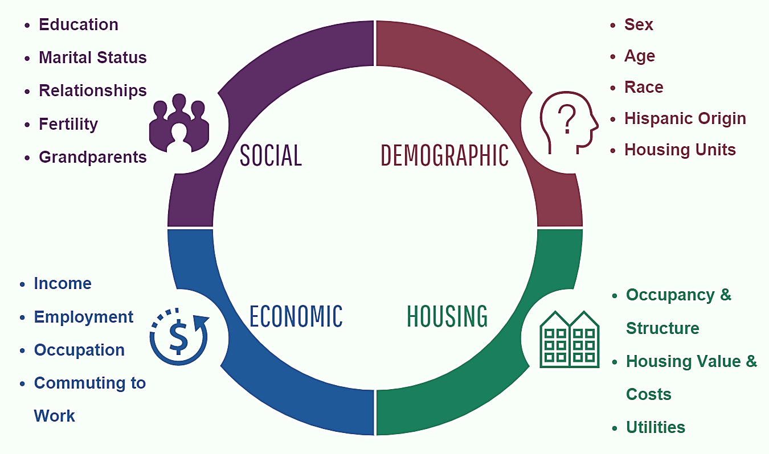
American Community Survey Topic Areas

Slide 6

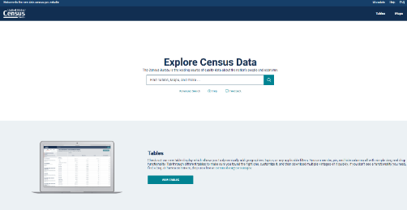
Finding the Data You Need
data.census.gov
Data.census.gov is the Census Bureau’s main data tool. It is the platform to access demographic and economic data from the Census Bureau.
Use when you need to access:
Specific data tables
Data profiles
Detailed data tables
Detailed thematic maps
Microdata tool
Explore Census Data

Slide 7

Accessing the data you need: data.census.gov

Slide 8

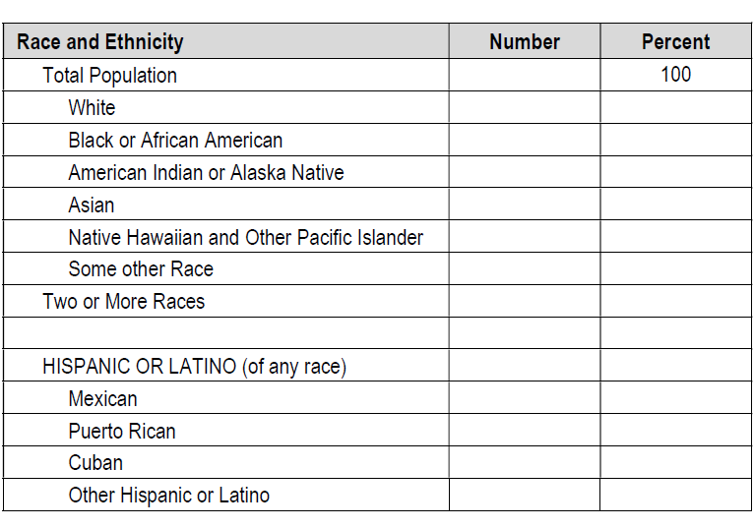
Page 28, Appendix D
DP05: Demographic and Housing Unit Estimates:
https://data.census.gov/table/ACSDP5Y2024.DP05?q=dp

Slide 9

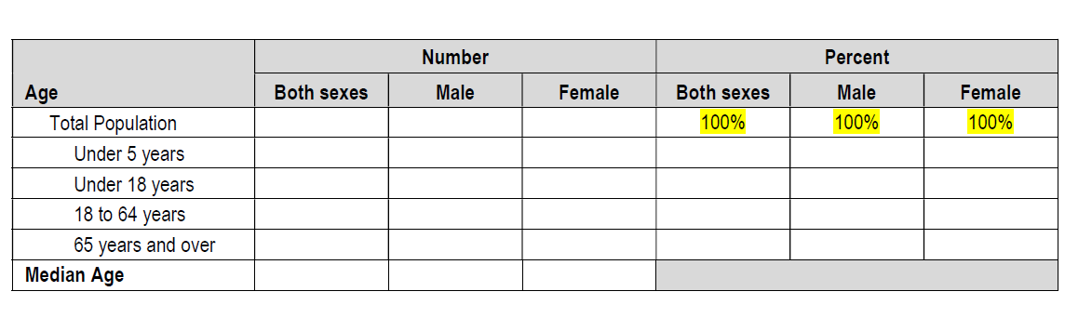
Page 28, Appendix D
The Census table does not provide a direct estimate for the 18–64 age group.
Population 18–64
Total − (Under 18 + 65 years and over) = Population 18–64
Repeat this same calculation for Male and Female.
Percent Population 18–64
Percent = (Population 18–64 ÷ Total population) × 100
Calculate the percent for Total, Male, and Female using the corresponding totals.
Do not average the percentages.
S0101: Age and Sex
https://data.census.gov/table/ACSST5Y2024.S0101?q=age+and+sex

Slide 10

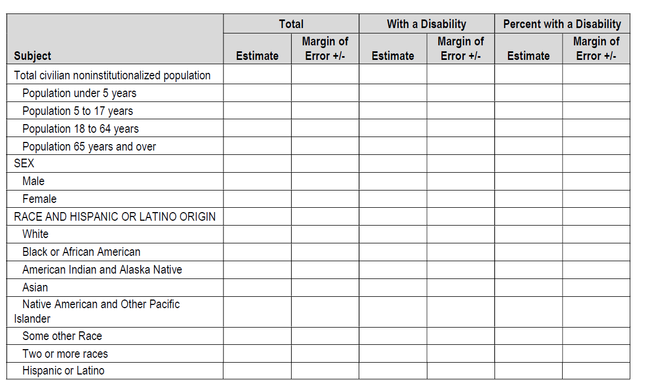
Page 29, Appendix D
Using the Census data table linked below to calculate the following:
Population 18–64 18–34 + 35–64 = Population 18–64
Population 65 Years and Over 65–74 + 75 and over = Population 65 years and over
Repeat this same process for With a Disability.
Percent with a Disability
(Total with a disability ÷ Total population) × 100= Percent with a disability
Use the derived totals for the age group.
Margin of Error (MOE): Use the ACS Statistical Calculator Spreadsheet to calculate the combined MOEs. Use the StdErrDiffSum tab.
S1810: Disability Characteristics
https://data.census.gov/table/ACSST5Y2024.S1810?q=disability

Slide 11

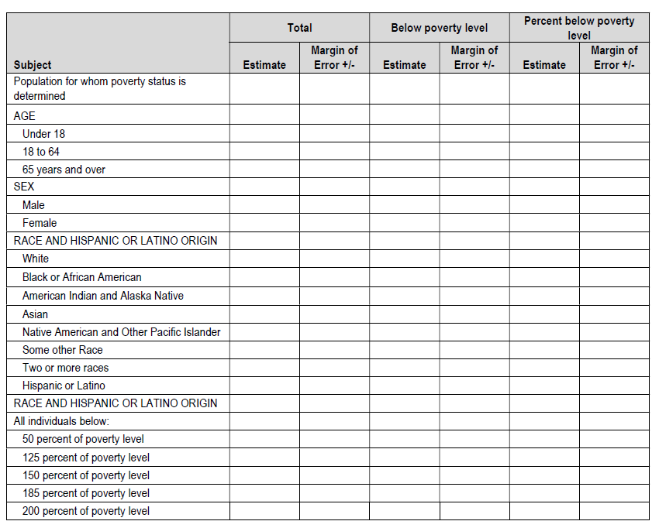
Page 30, Appendix D
Poverty Table – Important Denominator Note
Do not use the percentages shown in the Census table.
In the Census table, percentages are based on the population below poverty.
For this table, use the population for whom poverty status is determined as the denominator.
Use the ACS Statistical Calculator (Prop tab) with your selected numerator and denominator to generate both the percentage and MOE
S1701: Povery Status in the Past 12 Months
https://data.census.gov/table/ACSST5Y2024.S1701?q=poverty

Slide 12

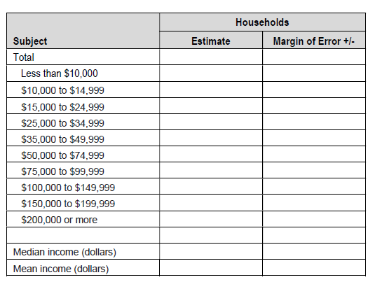
Page 31, Appendix D
S1901 Income in the Past 12 Months
https://data.census.gov/table/ACSST5Y2024.S1901?q=household+income

Slide 13

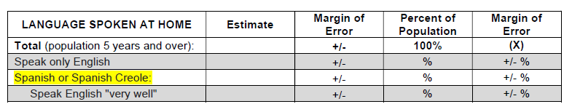
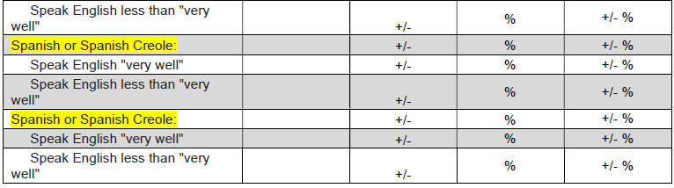
Language Table – Important Denominator Note
Do not use the percentages shown in the
Census table.
In the Census table, percentages are based on the population who speak a language other than English.
For this table, use the total population age 5 and over as the denominator.
Use the ACS Statistical Calculator (Prop tab) with your selected numerator and denominator to generate both the percentage and MOE.
Refer to your plan template for reporting requirements and thresholds.
Page 8- 9, main document, factor #1 in four factor analysis
Factor #1 in the Four Factor Analysis
S1601: Language Spoken at Home
https://data.census.gov/table/ACSST5Y2024.S1601?q=language+spoken+at+home

Slide 14
Resources + Contact Us

Slide 15

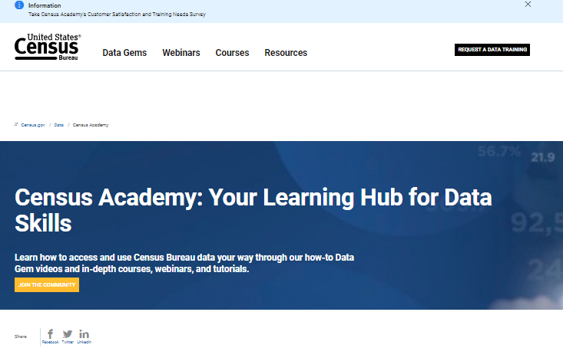
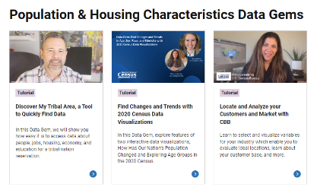
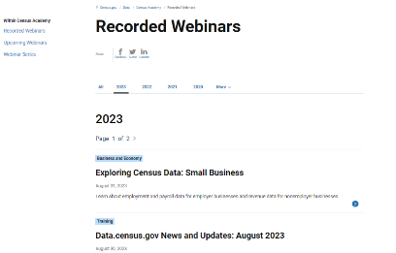
Independent Learning on All Census Topic Areas and Tools: Webinars, Data Gems and Courses on Census Academy
Census Academy

Slide 16

Resources & Contact Information
Contact us:
Kelly Karres
Kelly.karres@census.gov
704-726-7829
Ask Data
Census.askdata@census.gov
1-844-ASK-DATA
Links to Tools & Resources on census.gov:
Data Tools and Apps (census.gov)
QuickFacts FAQs
data.census.gov Resources
Index A-Z
Census Glossary
Census Academy
OnTheMap (census.gov)

Slide 17
THANK YOU

